Slide 1
Authentication and Access Control
Information Security

Slide 2
Identification and Authentication
Multi Factor Authentication
What information might we use to enable an individual to confirm the identity?
What the person knows - e.g. Password, PIN
What the person has - e.g. Smart Card, ID Number
What the person is – e.g. Biometrics (Fingerprints, Retina)
Where the person is – Location
What the person do - Gestures
Can use alone or combined
All can provide user authentication

Slide 3
Identification and Authentication
Multi Factor Authentication
What you know
An example of this type of Authentication is a "Password".
The simple logic here is that if you know the secret password for an account, then you must be the owner of that account.
The problems associated with this type of Authentication is that the password can be stolen, someone might read it if you wrote it somewhere.
If anyone came to know your password, he might tell someone else. If you have a simple dictionary password, it is easy to crack it by using password cracking software.

Slide 4
Identification and Authentication
Multi Factor Authentication
What you have
Examples of this type of authentication are smart cards, tokens etc.
The logic here is if you have the smart card with you, you must be the owner of the account.
The problems associated with this type of authentication are you might lose the smart card, it can be stolen, or someone can duplicate the smart card etc.

Slide 5
Identification and Authentication
Multi Factor Authentication
What you are
Examples of this type of authentication are your fingerprint, handprint, retina pattern, voice etc.
Problems associated with this type of authentication are that there is a chance of false positives and false negatives.
Chances are there that an invalid user is accepted and a valid user is rejected. Often people are not comfortable with this type of authentication.
False Positive (also called False Acceptance)
False Negative (also called False Rejection)
Notes:
False Positive (also called False Acceptance) is a probability of stating wronlgy that a biometric sample belongs to a certain person (in fact not the real guy).
For example, your phone gets unlocked by facial recognition when some other guy (not you) is showing his face to it. What’s the probability of that to happen? Quite low? Well, it should be!
False Negative (also called False Rejection) is a probability of stating wrongly that a biometric sample does not belong to a certain person (in fact the real guy).
For example, you are placing your finger onto a fingerprint scanner of your phone to get it unlocked, but it says it didn’t recognize you. What’s the probability of that to happen? But that happens all the time! Because it’s okay to just ask you to do it again. No big deal.

Slide 6
Identification and Authentication
Multi Factor Authentication
Where you are
Network administrators can implement services that use geolocation security checks to verify the location of a user before granting access to an application, network, or system.
IP addresses are a useful factor for assessing the origin of network traffic, but hackers can use VPNs to hide their location.
MAC addresses, which are unique to individual computing devices, can be implemented as a location-based authentication factor to ensure that a system is only accessed from a limited number of authorized devices.

Slide 7
Identification and Authentication
Multi Factor Authentication
What you do
Something you do is a type of authentication which proves identities by observing actions. These actions could be things like gestures or touches.
Windows 8 has a feature called Picture Password. This feature allows the user to set up gestures and touches on a picture as a way to authenticate themselves.
To set up a Picture Password, you need to first choose a picture, then mark it with actions (drawing a circle or a line or just clicking on a specific spot).
What you do - Windows authentication

Slide 8
Identification and Authentication
Multi Factor Authentication
Out-of-Band Authentication
Out-of-Band (OOB) means that authentication factors are transmitted via different channels or networks.
This means that the device you use to enter a factor (e.g. something you know), is different than the device you use to receive or generate another factor (e.g. something you have).
For instance, if you are on a website in your computer and you enter your username and password and a token is required next, the token needs to be generated by a different channel — an application on a cell phone

Slide 9
Identification and Authentication
Authentication Protocols: Kerberos
It was developed at MIT to provide authentication for UNIX networks. Today, Kerberos is the default Windows authentication method, and it is also used in Mac OS X and Linux.
The Kerberos protocol is a secure protocol, and it provides mutual authentication between a client and a server.
In Kerberos protocol, the client authenticates against the server and also the server authenticates itself against the client.
With mutual authentication, each computer or user can verify the identity of each other.
Notes:
MIT - Massachusetts Institute of Technology

Slide 10
Identification and Authentication
Authentication Protocols: Kerberos
After a client and server has used Kerberos to prove their identity, they can also encrypt all of their communications to assure privacy and data integrity
Kerberos is extremely efficient for authenticating clients in large enterprise network environments.
Kerberos requires the authentication server to be continuously available, and it requires clocks on different parts of the network to always be synchronized.

Slide 11
Identification and Authentication
Authentication Protocols: Kerberos Working
Kerberos protocol is built on top of a trusted third party, called as Key Distribution Center (KDC).
Key Distribution Center (KDC) acts as both an Authentication Server and as a Ticket Granting Server.
When a client needs to access a resource on the server, the user credentials (password, Smart Card, biometrics) are presented to the Key Distribution Center (KDC) for authentication.

Slide 12
Identification and Authentication
Authentication Protocols: Kerberos Working
If the user credentials are successfully verified in the Key Distribution Center (KDC), Key Distribution Center (KDC) issues a Ticket Granting Ticket (TGT) to the client.
The Ticket Granting Ticket (TGT) is cached in the local machine for future use.
The Ticket Granting Ticket (TGT) expires when the user disconnects or log off the network, or after it expires. The default expiry time is one day (86400 seconds).

Slide 13
Identification and Authentication
Authentication Protocols: Kerberos Working
When the client wants to access a resource on a remote server, the client presents the previously granted and cached Ticket Granting Ticket (TGT) to the authenticating KDC.
The authenticating Key Distribution Center (KDC) returns a session ticket to the client to access to the resource.
The client presents the session ticket to the remote resource server. The remote server allows the session to be established to the resource after accepting the session ticket.

Slide 14
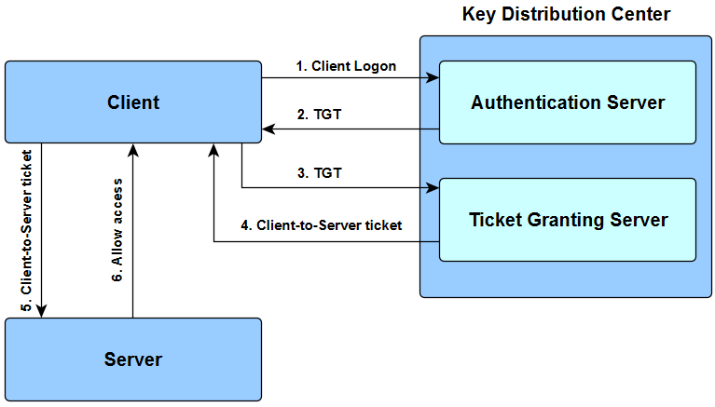
Identification and Authentication
Authentication Protocols: Kerberos Working

Slide 15
Identification and Authentication
Authentication Protocols: CHAP
Challenge Handshake Authentication Protocol (CHAP)
Challenge Handshake Authentication Protocol (CHAP) periodically verify the identity of the peer using a three-way handshake.
The Challenge Response Authentication Protocol, is basically, one entity sends a challenge to another entity and a second entity must respond with an appropriate answer in order to be authenticated.

Slide 16
Identification and Authentication
Authentication Protocols: CHAP
Challenge Handshake Authentication Protocol (CHAP)
The verification the identity of the peer is done initially, and may be repeated anytime after the link has been established.
Microsoft Challenge-Handshake Authentication Protocol (MS-CHAP) is the Microsoft implementation of Challenge Handshake Authentication Protocol (CHAP).

Slide 17
Identification and Authentication
Authentication Protocols: CHAP Working
Challenge Handshake Authentication Protocol (CHAP)
The user opens an Application that needs to be logged in and provide Username and Password.
The client application computes a cryptographic hash of the password.
Discards the actual password.
The application sends the Username to the server in plaintext.
The server generates a 16-byte random number called a challenge.
Sends the challenge to the client application.
Notes:
Hashing is the process of converting a given key into another value. A hash function is used to generate the new value according to a mathematical algorithm. The result of a hash function is known as a hash value or simply, a hash.
A good hash function uses a one-way hashing algorithm, or in other words, the hash cannot be converted back into the original key.

Slide 18
Identification and Authentication
Authentication Protocols: CHAP Working
Challenge Handshake Authentication Protocol (CHAP)
The application receives the challenge and encrypts it using the hash of the password.
The application sends the resulting encrypted challenge to the server.
The server uses the previously received username to retrieve the hash of the user’s password from the database.
The server encrypts the original challenge using the password hash.
The server compares the encrypted challenge against the response computed from the application for the challenge.
If they are similar, then the authentication is granted.

Slide 19
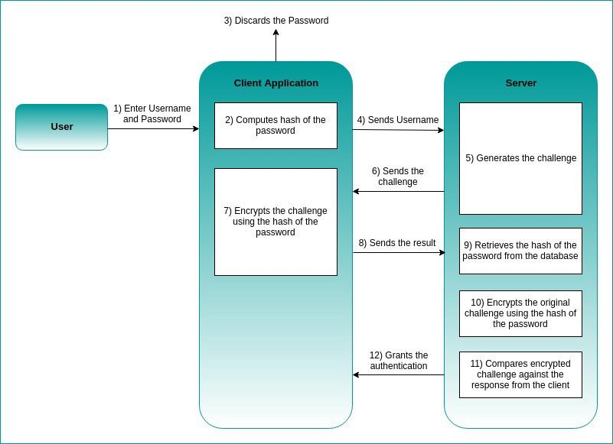
Identification and Authentication
Authentication Protocols: CHAP Working
Notes:
User Input: The user enters their Username and Password into the Client Application.
Client Hashing: The Client immediately converts the Password into a secure, scrambled code called a hash.
Password Discarded: The original password is thrown away by the client, so it never leaves the user's device.
Username Sent: The Client sends only the Username to the Server.
Server Challenge: The Server generates a unique, random question (a challenge).
Challenge Sent: The Server sends this challenge back to the Client.
Client Encrypts: The Client uses the hash (the scrambled code from step 2) to encrypt the challenge. This encrypted answer is the proof of identity.
Result Sent: The Client sends this encrypted result (the answer) to the Server.
Server Verification (Steps 9-10):
The Server looks up the user's stored hash (the same scrambled code, stored from when the user signed up).
The Server uses its stored hash to encrypt the original challenge it sent.
Comparison: The Server compares the encrypted answer it just generated with the encrypted answer received from the client.
Authentication: If the two encrypted answers match, it proves the Client had the correct password (and therefore the correct hash), and the Server grants Authentication.

